Slide 1

Hosting a Portfolio website directly with AWS
INT 391 Internship 2
Pavithraa.M – E5221031
Project Guide :
Ms.Aruna

Slide 2
Introduction
Creating an online portfolio is essential for showcasing skills, projects, and professional experiences. Creating a portfolio website using HTML and CSS is a foundational approach to web development that allows you to showcase your work in a visually appealing and structured manner. Integrating JavaScript into your portfolio website enhances interactivity and user experience, especially for displaying testimonials. Hosting a portfolio website on Amazon Web Services (AWS) offers a powerful and flexible solution, leveraging Amazon S3 for storage and EC2 instances for hosting. Its integration with AWS services ensures fast content delivery and robust data management. This combination of S3 and EC2 allows for a robust, scalable, and cost-efficient solution for hosting a professional portfolio website.

Slide 3
Problem statement/Objectives
In today's digital age, a professional online portfolio is crucial for individuals to showcase their skills, projects, and achievements. However, many face challenges in finding a hosting solution that is both scalable and cost-effective. Traditional hosting services often come with limitations in terms of storage capacity, performance under varying traffic loads, and ease of integration with other services. This project aims to leverage AWS's global infrastructure to host a portfolio website, ensuring minimal latency and optimal speed for users worldwide.

Slide 4
Research/Product survey
A portfolio website using HTML and CSS is a foundational approach to web development that allows you to showcase your work in a visually appealing and structured manner. In the context of portfolio websites, JavaScript can be particularly effective for managing testimonials, allowing for dynamic display and interactive navigation.Miller (2013) and Barr (2017) describe how AWS's global infrastructure ensures high availability and low latency and EC2 provides customizable and scalable computing power for dynamic content and applications.
Research Papers:
Mgarbi, Hanae, Mohamed Yassin CHKOURI, and Abderrahim Tahiri. "BUILDING STUDENT RESUME USING THE E-PORTFOLIO APPROACH." International Journal of Engineering Applied Sciences and Technology 6.5 (2021).
Nadon J. Website Hosting and Migration with Amazon Web Services: A Practical Guide to Moving Your Website to AWS. Apress; 2017 May 8.
Martins, Paulo Jorge Pereira. Development of an e-portfolio social network using emerging web technologies. Diss. 2022.

Slide 5
Work Flow/Methodology
Website
HTML
CSS
Interactivity of the website
Javascript
Hosting the website with AWS

Slide 6
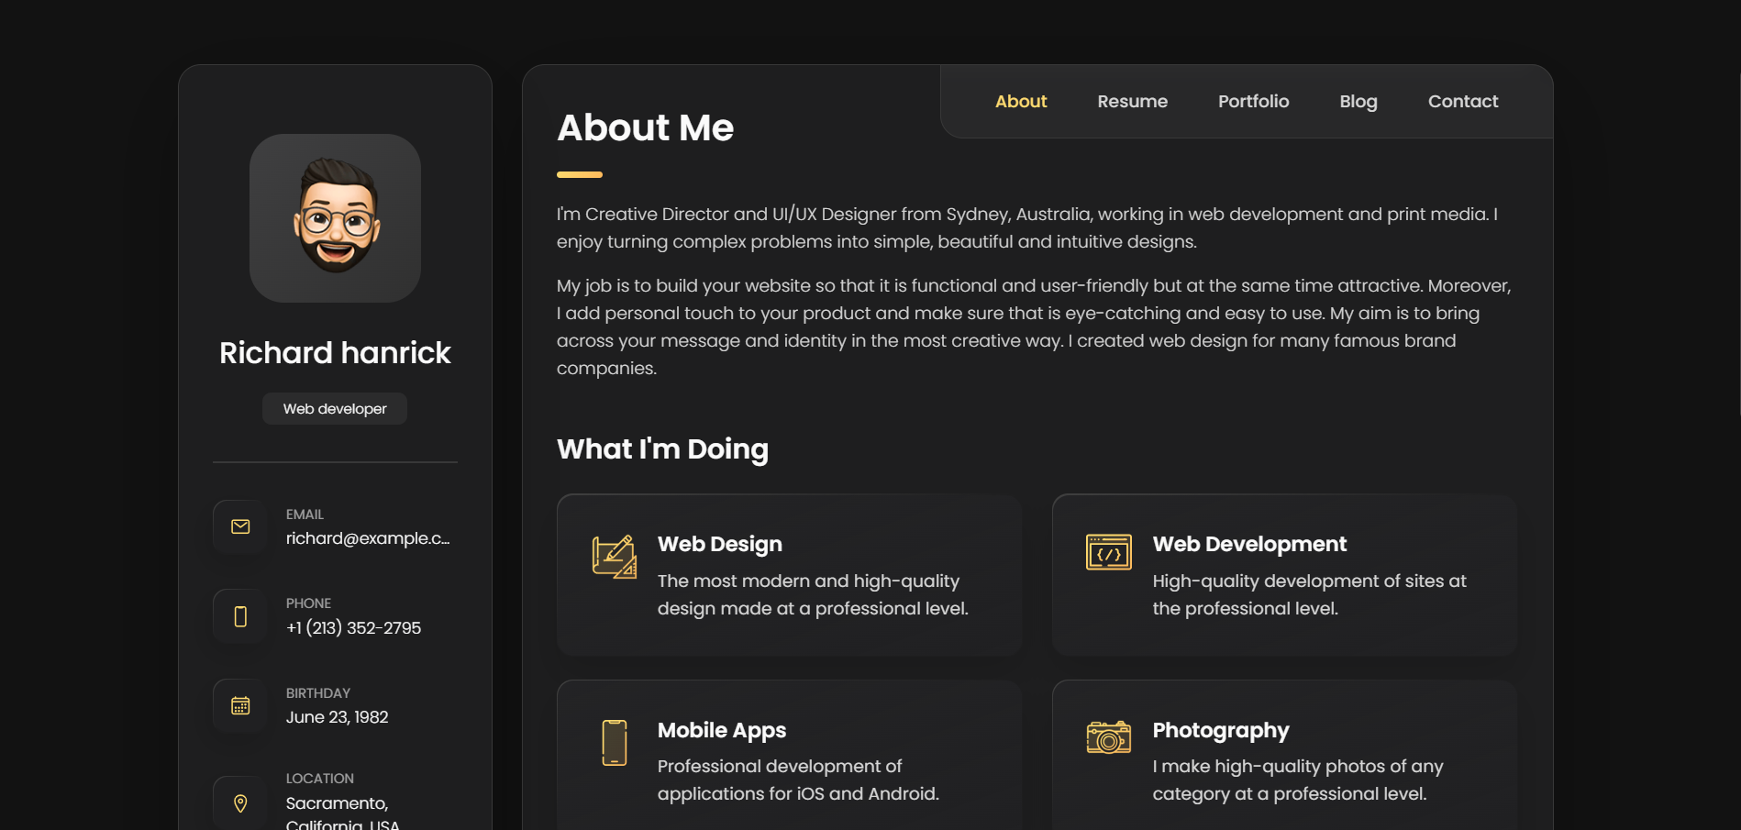
Work done

Slide 7
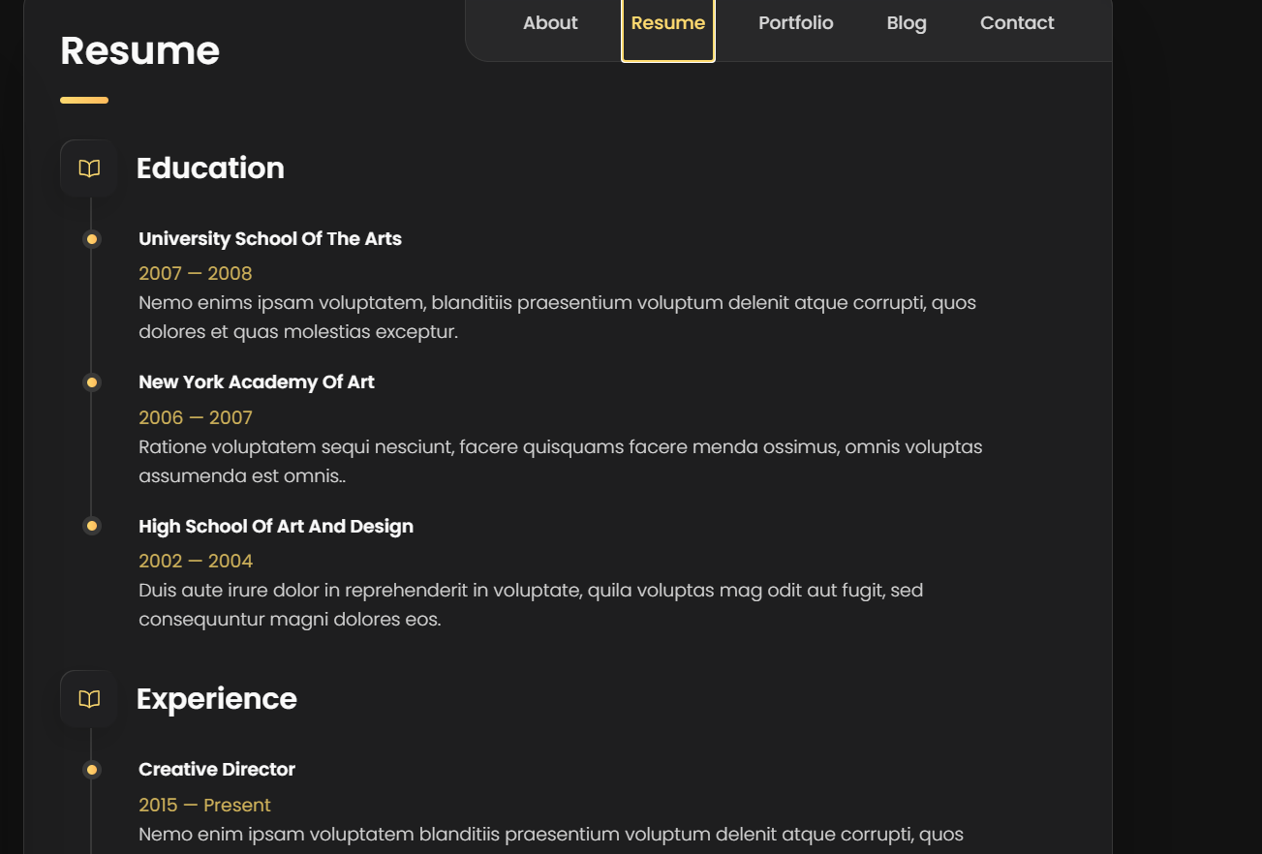
Work done

Slide 8
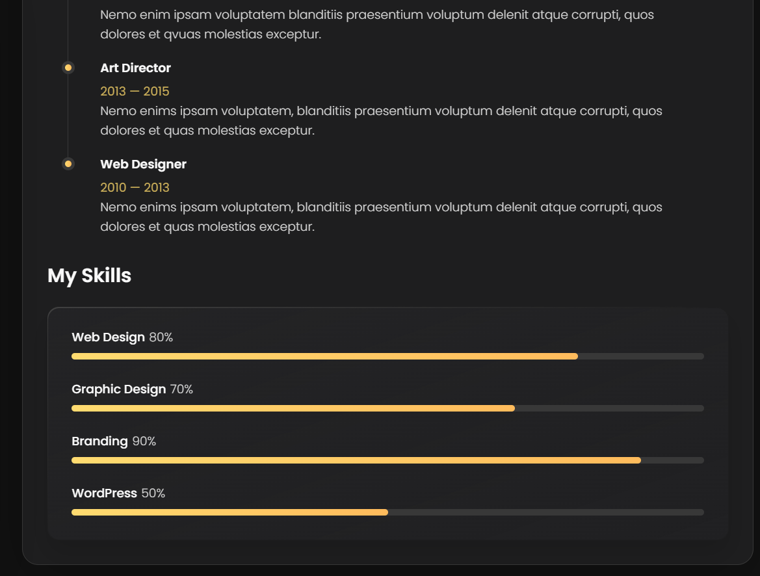
Work done

Slide 9
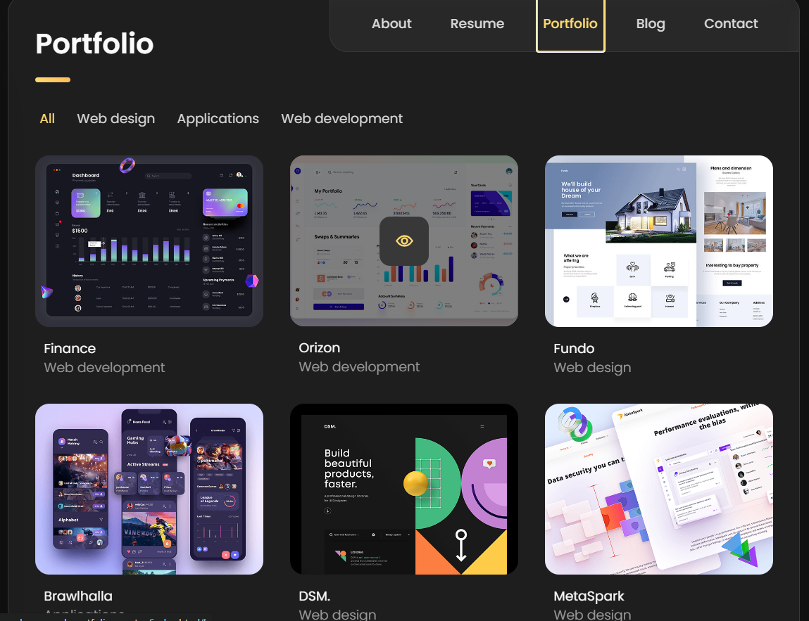
Work done

Slide 10
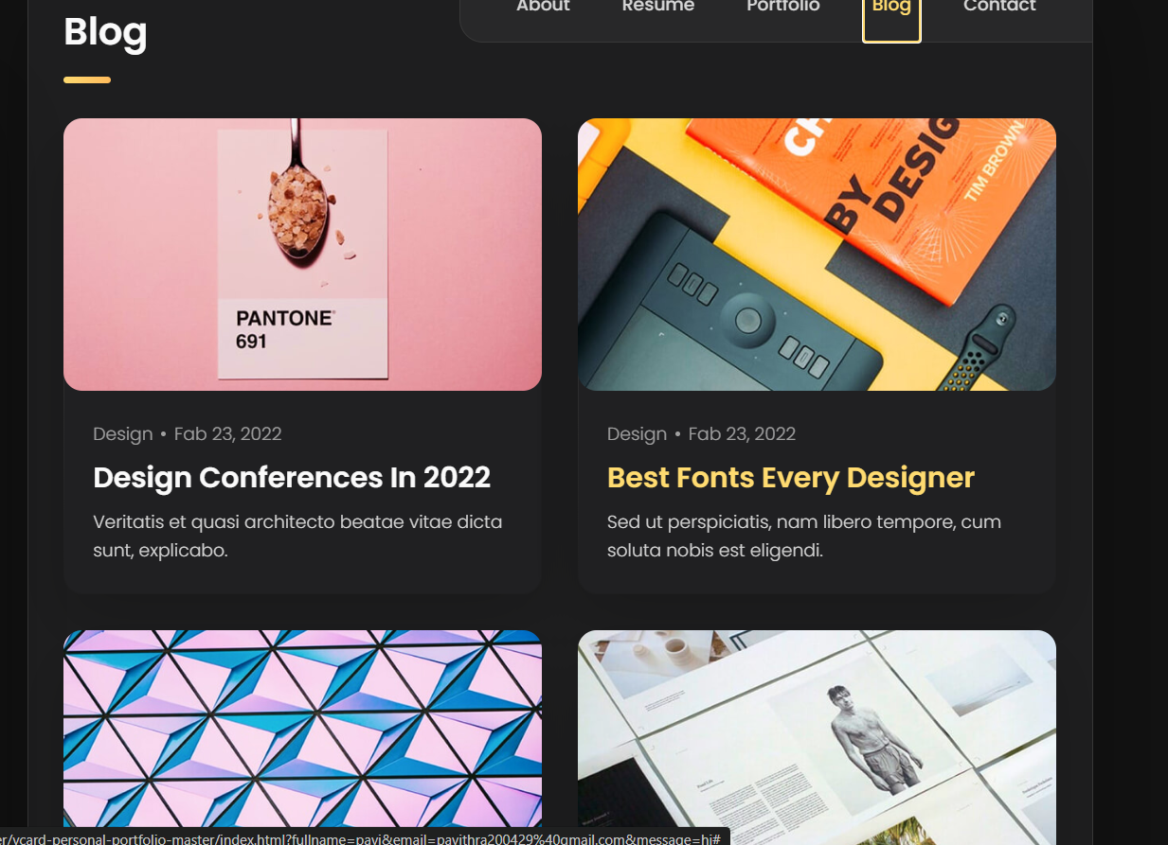
Work done

Slide 11
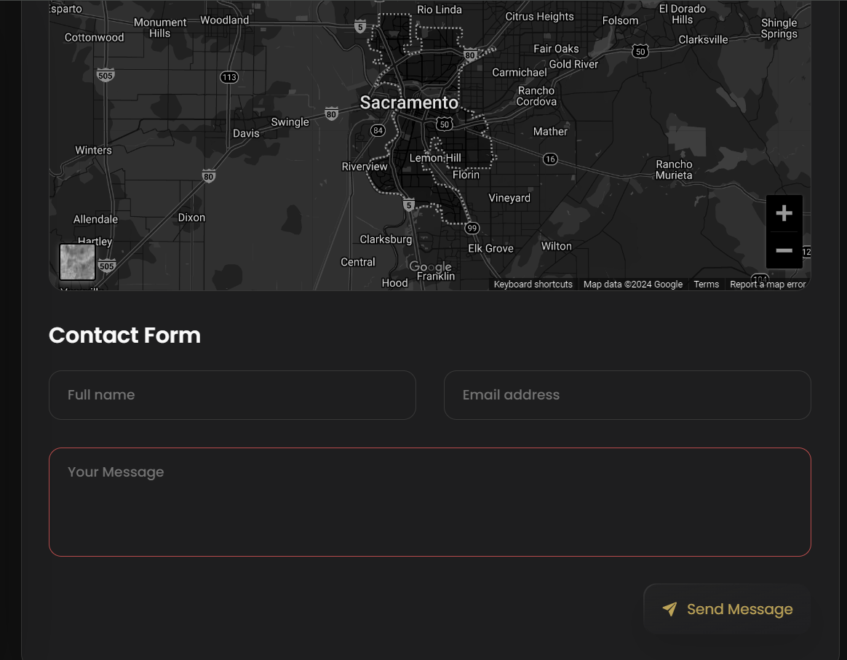
Work done

Slide 12
Timeline of the work
DATE | WORK DONE
02/05/24 – 08/05/24 | Discussed on the project topics
09/05/24 – 15/05/24 | Conformed the topic and started the research survey
18/05/24 – 22/05/24 | Started working on website
23/05/24 – 26/05/24 | Completed the website using HTML and CSS
27/05/24 | Completed the first review
28/05/24 – 04/06/24 | Gone through the you-tube videos regarding Java Script, to integrate it in the website.
05/06/24 – 10/06/24 | Started working on the Java Script
11/06/24 – 13/06/24 | Completed the integration of the Java Script in the website
14/06/24 | Completed the second review.
16/06/24 – 18/06/24 | Gone through some research papers similar to hosting the website.
19/06/24 – 21/06/24 | Gone through you-tube videos regarding AWS.
22/06/24 – 25/06/24 | Started working with the AWS.
26/06/24 | Completed the project and started working with the report.
27/06/24 | Report submission.
28/06/24 | Final review.

Slide 13
Thank you

